Slide 1
Orchestration
for Complex Appliances

Slide 2
You hear about some new analytical techniques
Gather code
???
Profit/Publish

Slide 3
You hear about some new analytical techniques
Gather code
Hope the developer documented how to run it
Profit/Publish

Slide 4
Repository
Services
Code
Code
Resources
Usability
Cost
Citations

Slide 5
Repository
Services
Code
Code
Code
Environment
Environment
Resources
Usability
Cost
Citations

Slide 6
Repository
Services
Code
Code
Code
Environment
Environment
Appliance
Resources
Usability
Cost
Citations

Slide 7
Save the Environment
Operating System
Distribution packages
Libraries and their versions
Runtimes
Supporting services
Databases
Web servers
Where things are expected to be
Disk Images
Scripts

Slide 8
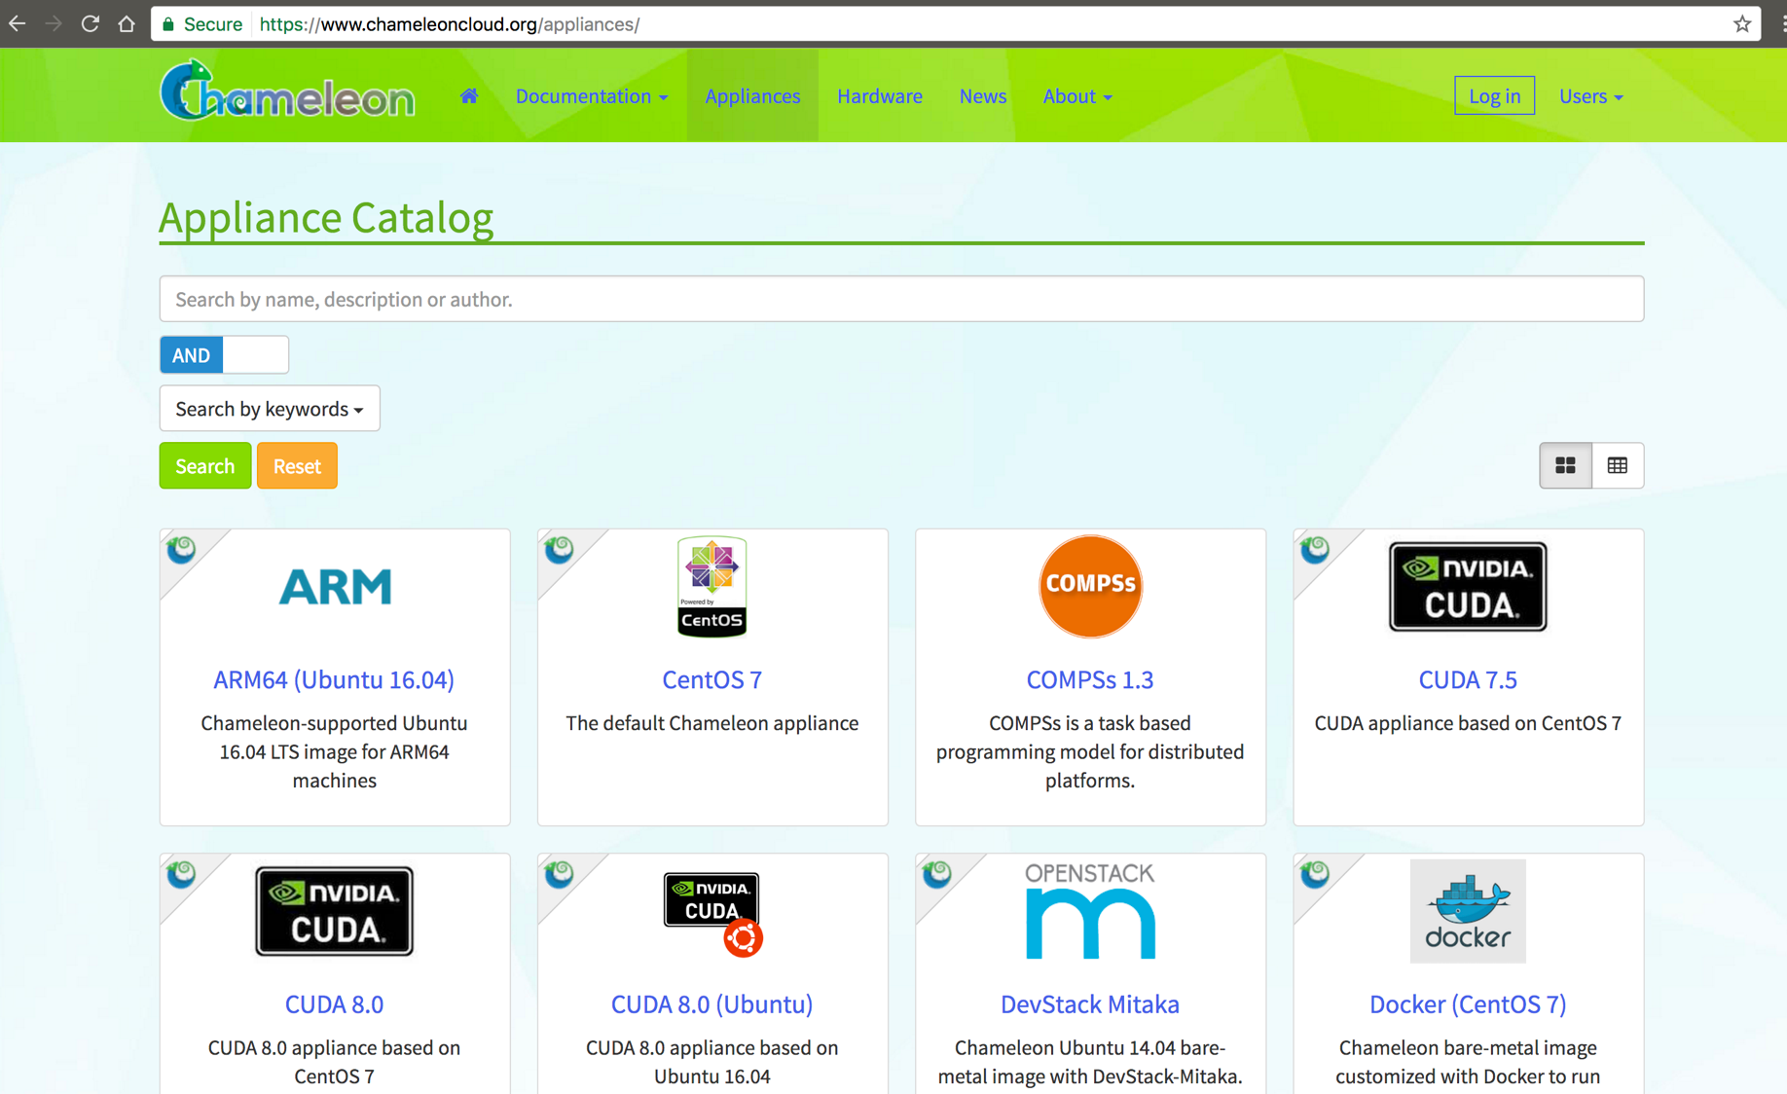

Slide 9
(Simple) Appliance
Image
App
Service
Service
Runtime
Docs

Slide 10
Image

Slide 11
Manual Cluster Deployment Example
Image
Provision some nodes with the Image
Get the IP of each node
Compile an /etc/hosts file with the hostnames and IPs
Log into each node (possibly through a gateway) and push the file to all nodes
Configure instances as master or slaves
…
Tedious. Finicky. Boring.

Slide 12
Instance
Image

Slide 13
Instance
IP Address
Image

Slide 14
Security Group
Instance
IP Address
Image

Slide 15
Security Group
Instance
Security Group
IP Address
Image
Instance
Instance

Slide 16
Security Group
Instance
Security Group
IP Address
Image
Instance
Scripts
Docs
Instance

Slide 17
Complex Appliance
Security Group
Instance
Security Group
IP Address
Image
Instance
Scripts
Docs
Instance

Slide 18
A “complex appliance” is a way to define multiple resources and orchestrate their deployment for reuse.

Slide 19
Can we automate it?
Cloud Providers
Orchestration Service
Heat

Slide 20
How do they work? Templates.
Define resources and how they’re related
Configuration scripts allow all-to-all information exchange
Can take inputs, e.g.:
number of nodes in a cluster
instance flavor
Can provide outputs, e.g.:
IP address
script that ran on the master node

Slide 21
Examples
https://github.com/nicktimko/heat-tutorial/tree/master/templates

Slide 22
Sidebar: Yet Another Markup Language
JSON
YAML
{
'pears': 2,
'apples': [
'gala',
'jonathan',
'spy'
]
}
pears: 2
apples:
- gala
- jonathan
- spy
More at http://www.yaml.org/start.html

Slide 23
Requirements to use a Template
Need account on service provider (ROGER, Chameleon, AWS)
Need to know how to launch templates
Need to transport data, code, images yourself

Slide 24
LambdaLink manages appliances on resources
Appliances
LambdaLink
ROGER
Chameleon
AWS
Resources

Slide 25
Design Goals
Allow deployment of appliances across multiple clouds
One interface, multiple providers
Use free resources
Multi-user access to applications
Provide services to unprivileged users
Imgur and Dropbox don't require you have an AWS account

Slide 26
Design Goals
Coerce developers to define the required environment to run their applications
Provide common environments across all clouds

